Slide 1
iPwn your iPhone – WiFi edition
Fun with with CVE-2011-0228
@hubert3
hubert@pentest.com

Slide 2
Agenda
Brief intro to SSL certs
The CVE-2011-0228 vulnerability
iSniff Demo

Slide 3
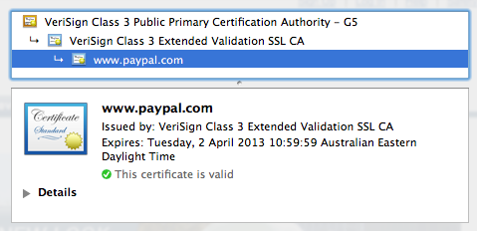
SSL certificate chains

Slide 4
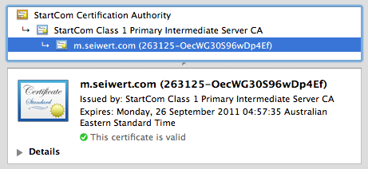
SSL certificate chains

Slide 5
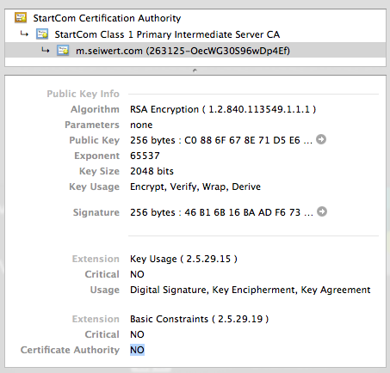
SSL certificate chains

Slide 6
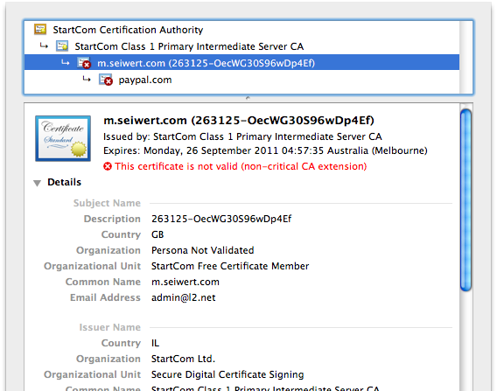
SSL certificate chains

Slide 7
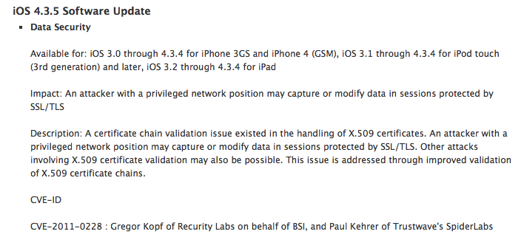
Patch…

Slide 8
Man-in-the-middle setup
Linux VM (Debian 6)
Netgear WG111v2 USB WiFi stick
R8187 driver from aircrack-ng
airbase-ng
dhcpd
iSniff.py

Slide 9
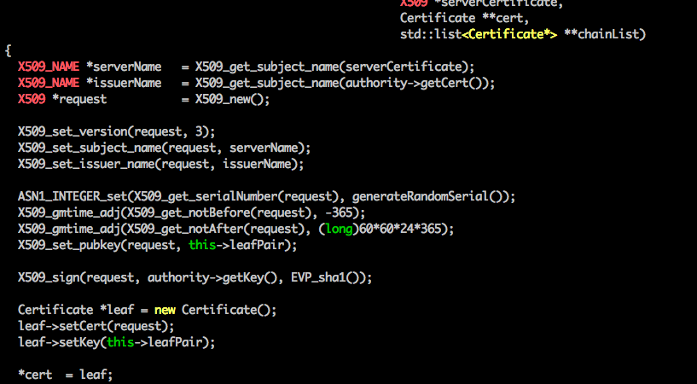
sslsniff 0.8 AuthorityCertificateManager.cpp

Slide 10
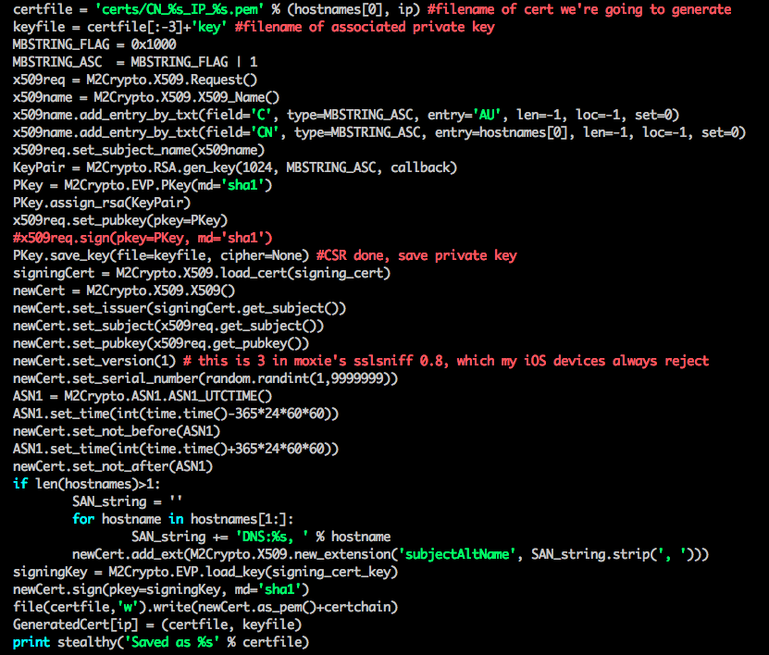
iSniff.py

Slide 11
iSniff Demo

Slide 12
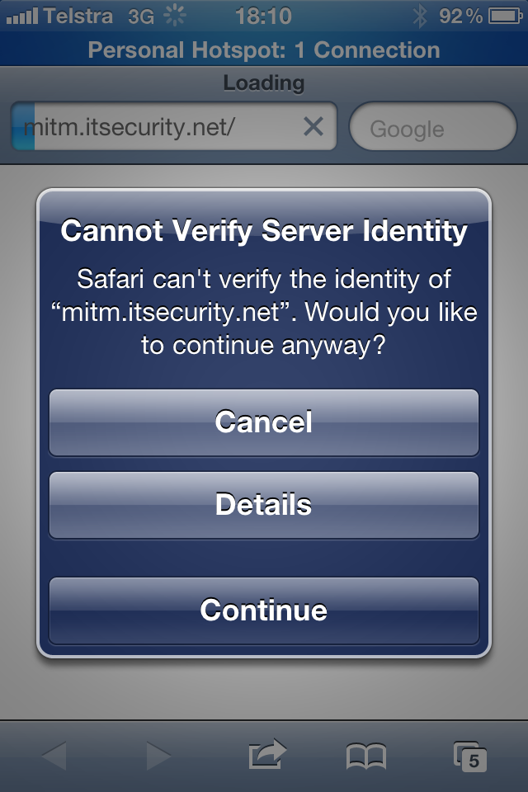
After patch…

Slide 13
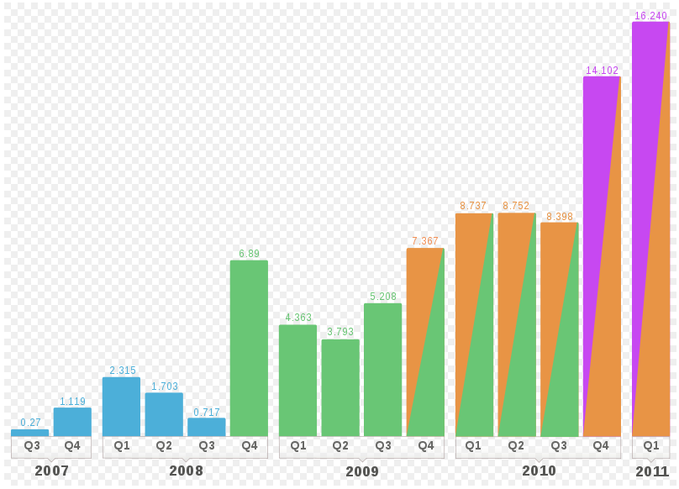

Slide 14
Resources
https://github.com/hubert3/iSniff
Airbase-ng wifi setup:
http://adaywithtape.blogspot.com/2009/10/fake-ap-using-airbase-ng.html
Advisories:
https://www.trustwave.com/spiderlabs/advisories/TWSL2011-007.txt
http://blog.recurity-labs.com/archives/2011/07/26/cve-2011-0228_ios_certificate_chain_validation_issue_in_handling_of_x_509_certificates/index.html

