Slide 1
Fun and Games with SSL Traffic Analysis
Vincent Berg <vberg@ioactive.com>

Slide 2
Outline
What is Traffic Analysis?
Why SSL Traffic Analysis?
HTTP/SSL specific Traffic Analysis
Examples
Libtrafficker
Having fun with Google Maps

Slide 3
What is traffic analysis?
“deduce information from patterns in communication”
-- Wikipedia

Slide 4
What is traffic analysis? (2)
Use traffic data
Identities or call signs of communicating parties
Time, duration and length of communication
Location of sender or receiver
NO content!!
For more info see George Danezis’ webpage (http://research.microsoft.com/en-us/um/people/gdane/)

Slide 5
Examples
Operation Quicksilver
Brits fed German intelligence true and false info on troop deployments
German intelligence assumed invasion at Pas-de-Calais and not in Normandy
Timing analysis of SSH keystrokes by Song, Dawn Xiaodong; Wagner, David; Tian, Xuqing (2001). Timing Analysis of Keystrokes and Timing Attacks on SSH. 10th USENIX Security Symposium
Analysis of Skype’s voice traffic

Slide 6
“Phonotactic Reconstruction of Encrypted VoIP Conversations: Hookt on fon-iks” by Andrew White, Austin Matthews, Kevin Snow, and Fabian Monrose.

Slide 7
Catching the highway shooter?

Slide 8
Why SSL traffic analysis?
SSL has been around since 1995
Tons of problems since then
Attacks on Certificate Authorities
SSL renegotiation attacks
Implementation errors
Usage insecure ciphers
Apple iOS bug (not validating cert chains, Aug 2011)
Diginotar disaster (news broke August 29th 2011)
So why bother with SSL traffic analysis?

Slide 9
Why SSL traffic analysis? (2)
Smart people are trying to fix SSL
Moxie Marlinspike who tries to replace Certificate Authorities check it out at: http://convergence.io/ (really cool)
Dan Kaminsky who tries to solve it by getting DNSSEC adopted
Many others
At some point “The Industry” will get it right
SSL is here to stay

Slide 10
Why SSL traffic analysis? (3)
So assuming that:
SSL is here to stay,
All its problems will be solved eventually,
The only* recourse an attacker than has is to look for patterns in the encrypted SSL stream
* ignoring all underlying protocol and routing attacks for convenience’s sake

Slide 11
$RANDOM protocol over SSL traffic analysis
Identify messaging patterns
Synchronous (Request-Reply)
Asynchronous
Identify message sizes
Identify timing patterns
Action x results in y delay in seconds

Slide 12
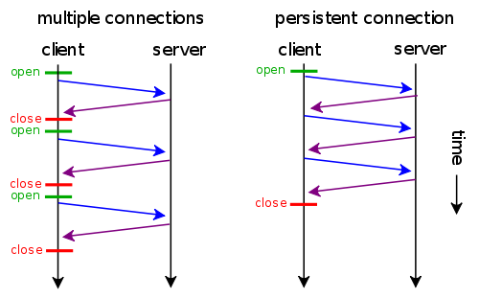
HTTPS traffic analysis
HTTP keep-alive

Slide 13
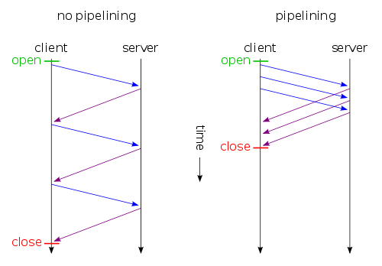
HTTPS traffic analysis (2)
HTTP pipelining (no major browser supports this by default)

Slide 14
HTTPS traffic analysis (3)
HTTP request sizes
Depend on URL length
User-Agent header
Possibly altered by browser plugins
Cookie length
Other HTTP headers
Inserted by browser plugins
Inserted by intermediate proxies
POST/PUT content
HTTP response sizes
Depend directly (mostly) upon the contents of the request

Slide 15
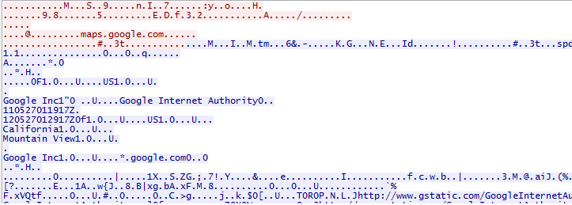
HTTPS traffic analysis (4)

Slide 16
HTTPS traffic analysis (5)

Slide 17
Libtrafficker
Simple wrapper around libpcap and libnids
Interface is similar to libpcap
Ability to buffer so-called ``bursts’’
A burst is a parsed SSL Application Data frame
If ``burst join`` is set they will be buffered until a communication direction switch occurs

Slide 18
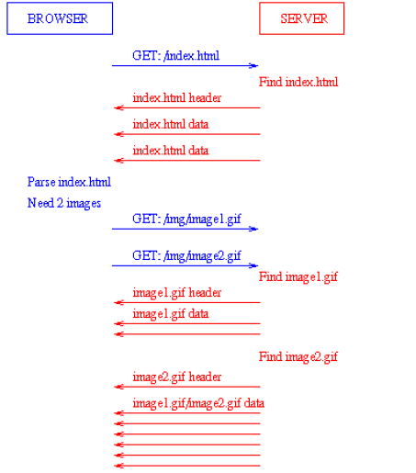

Slide 19
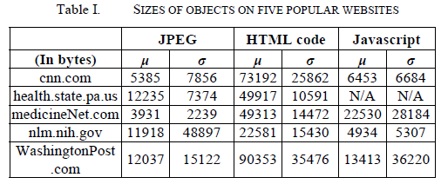
Examples
“Side-Channel Leaks in Web Applications: a Reality Today, a Challenge Tomorrow” http://research.microsoft.com/apps/pubs/?id=119060

Slide 20
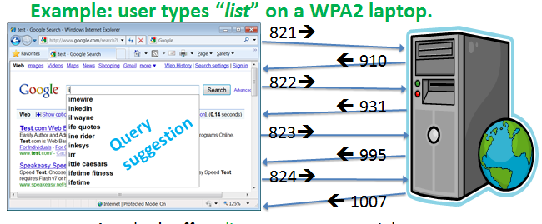
Examples (2)
OnlineHealth application
Attacker can infer diseases etc.

Slide 21
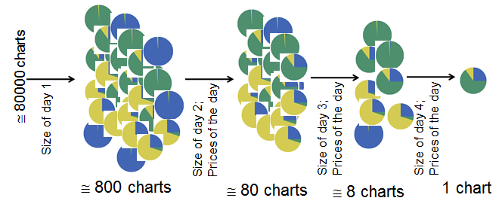
Examples (3)
OnlineInvest application
Reconstruct pie-charts!

Slide 22
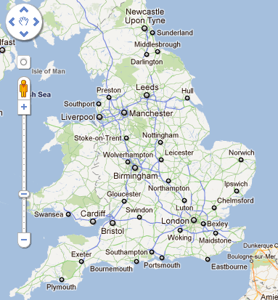
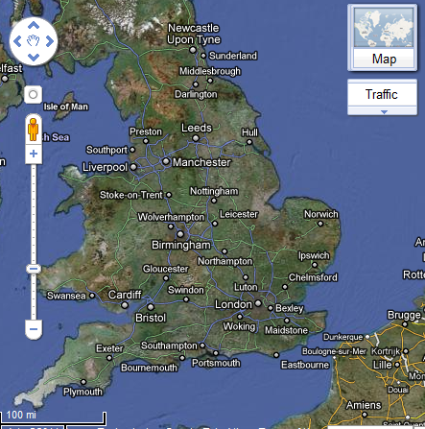
Traffic Analysis on Google Maps

Slide 23
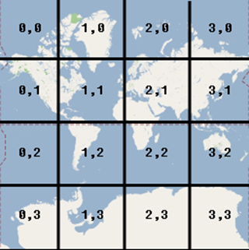
Google Maps architecture
Coordinate system (see: http://facstaff.unca.edu/mcmcclur/GoogleMaps/Projections/GoogleCoords.html)
Convert latitude, longitude and zoomlevel to (x,y,z) triplets.

Slide 24
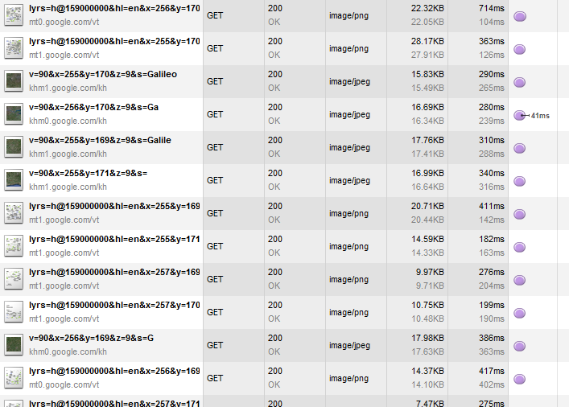
Google Maps traffic

Slide 25
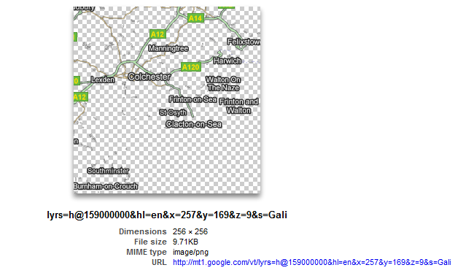
Overlay tiles
x,y,z = (257, 169, 9)

Slide 26
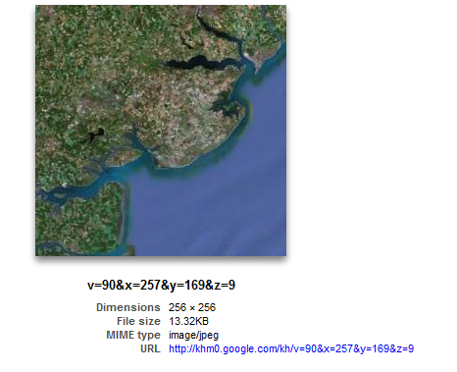
Satellite tile
x,y,z = (257, 169, 9)

Slide 27
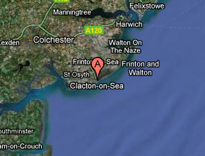
Combined
This image in your browser corresponds to two HTTP GET requests

Slide 28
Approach
Scrape satellite tiles
Create a database of image sizes mapped to (x,y,z) triplets
Differentiate between satellite tile requests and overlay tile requests
How? Can we even do this?
Map seen image sizes to (x,y,z) triplets
Try to map the list of triplets back to coordinates

Slide 29
gmaps-trafficker
Use GMapCatcher (0.7.5.0) to download satellite tiles
Use gmaps-profile to generate profile data
Run gmaps-trafficker
./gmaps-trafficker –L wlan0 –f profile.dat
./gmaps-trafficker –O capture.pcap –f profile.dat

Slide 30
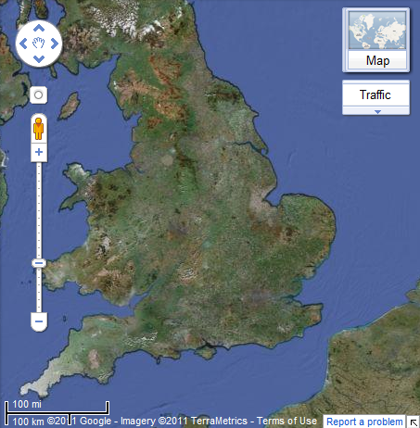
Traffic Analysis on Google Maps
$ host mt.google.com
mt.google.com CNAME mt.l.google.com
mt.l.google.com A 74.125.77.101
mt.l.google.com A 74.125.77.102
mt.l.google.com A 74.125.77.100
$ host khm.google.com
khm.google.com CNAME khm.l.google.com
khm.l.google.com A 74.125.77.101
khm.l.google.com A 74.125.77.102
khm.l.google.com A 74.125.77.100

Slide 31
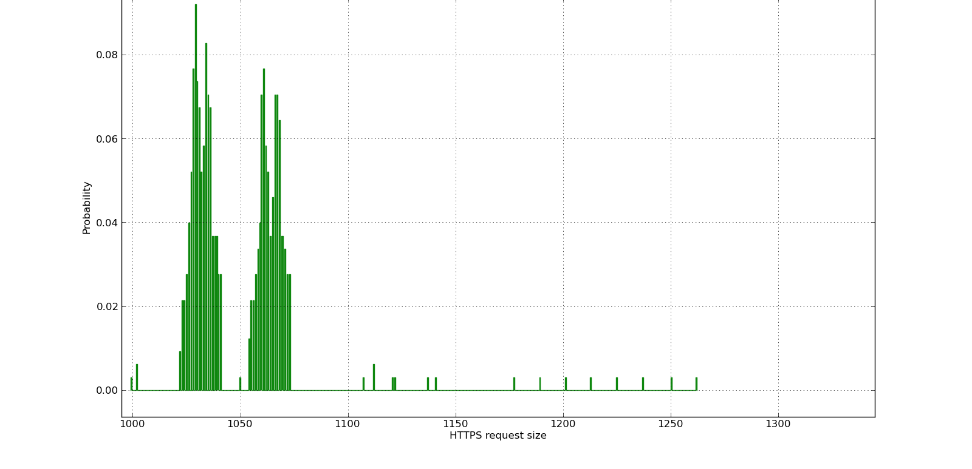
Google Maps (SSL) request sizes
Watch traffic and create histogram of request sizes

Slide 32
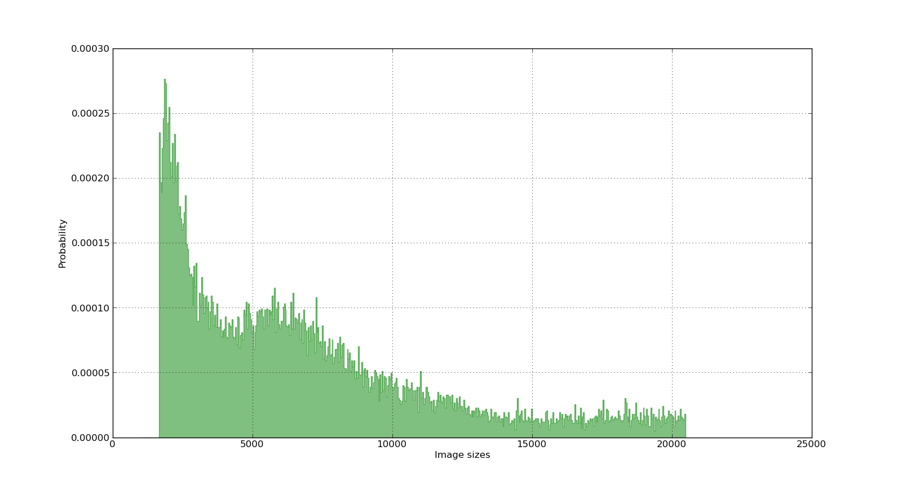
Google Maps (SSL) response sizes

Slide 33
Example sniffed HTTP response sizes
Image Size | Coordinate List
12358 | (1,2,3); (81,3,12); (144,45,8); …
19771 | (43,66,2); (12,55,3); …
9013 | (64,22,4); …
List of coordinates will get large fast
How do we convert this to something which might work?

Slide 34
Algorithm
For each zoomlevel z:
Generate a hashmap index on x and put the (x,y) values in it.
Generate a hashmap index on y and put the (x,y) values in it.
Search for straight line segments as follows:
For each x in the hashmap index on x look for adjacent y values.
For each x in the hashmap index on x look for adjacent y values.
Search for a combination of line segments that comprise an entire rectangle.
Return the list of rectangles for zoomlevel z.

Slide 35
Plotted coordinates for a zoomlevel

Slide 36
Demo
Profile data contains 5 European cities (Paris, Berlin, Amsterdam, Brussel, Geneva)
Movie can be found online at: http://www.youtube.com/watch?v=0XC-coz_UaY

Slide 37
Possible improvements
Scrape overlay images to reduce the number of matching coordinates
Only add coordinates when overlay + satellite image matches
Detect zooms better
Detect scroll actions (north, west, south and east)

Slide 38
Thanks!
@santaragolabs
http://www.santarago.org
(code + slides will be online here shortly)
vberg@ioactive.com gorny@santarago.org

